Slide 1
WHAT IS THE OBJECTIVE OF SECURITY ENGINEERING ?
Security architecture as per best-practices
The right security devices in the right places
Effective security configuration of security devices (features)
Optimum operation of security devices
Aggregate controls

Slide 2
WHAT IS THE OBJECTIVE OF SECURITY ENGINEERING ?
SECURITY ENGINEERING
STRUCTURE
OPERATION
FEATURES & CONFIG
ARCHITECTURE

Slide 3
WHAT IS THE OBJECTIVE OF SECURITY ENGINEERING ?
Examples:
FW first and then IPS
Edge FW, data center FW
Malware protection at the network edge
VPN termination on remote access VPN device
VPN tunnels for extranet connectivity

Slide 4
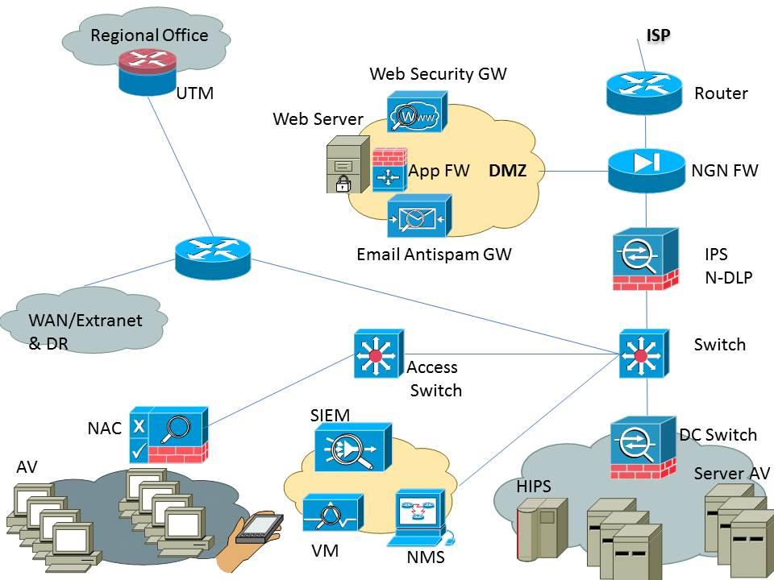
WHAT IS THE OBJECTIVE OF SECURITY ENGINEERING ?

Slide 5
WHAT IS THE OBJECTIVE OF SECURITY ENGINEERING ?
The right time for setting up security engineering is when a new network is being designed & implemented
Fixing a poorly architected operational network is an arduous task
END

